Slide 1
4COSCO11C.2 Web Design and Development
JavaScript and Forms
Week 8

Slide 2
Learning Outcomes
On completion of this lecture, students are expected to be able to:
Understand the concept of JavaScript Events and Event Handlers.
Demonstrate a good knowledge of different methods in JavaScript to access HTML form elements in hypertext documents.
Demonstrate a good level of knowledge on JavaScript to validate HTML form inputs in hypertext documents using Functions.

Slide 3
Getting and Setting input text field values
A function to check the length of a student username
<html>
<head>
<script>
function checkUserName( form ) {
if ( form.reg.value.length != 8 ) {
alert( "You have not entered an eight character string" );
return false;
} else {
alert( "This is correct" );
return true;
}
}
</script>
</head>
<body>
<p> Please enter your student username: <input type="text" name="reg" />
<input type="button" onclick="checkUserName(form);" value="check validity"/>
</body>
</html>

Slide 4
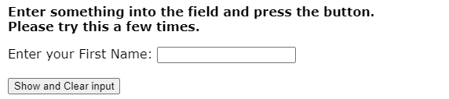
Form Validation
This form contains an input text field and an input button. (Click Lecture example)
The form is designed to demonstrate how to get and set the text in a text field. The html for the input button includes an event handler attribute. pressing the button calls a function that:
retrieves the value in the text field
displays the text in an alert dialog box
clears the text field by setting its value to an empty string: "“

Slide 5
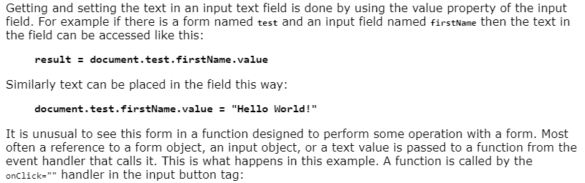
Accessing Form elements – Method 1

Slide 6
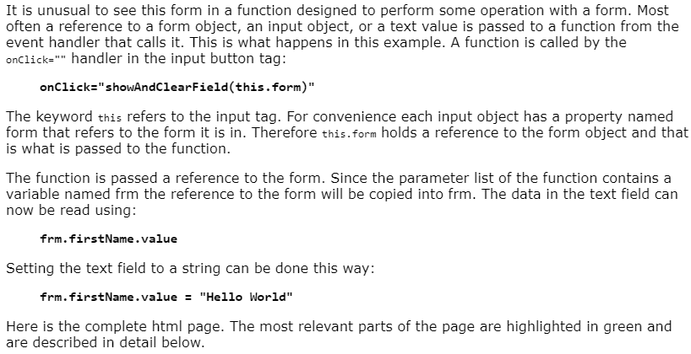
Accessing Form elements – Method 2

Slide 7
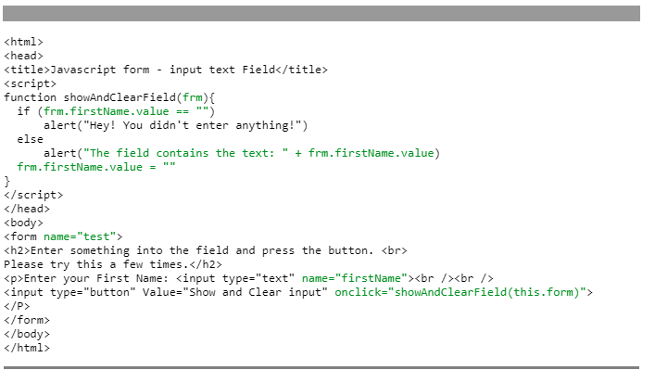
Accessing Form elements – Method 2
Here is the complete html page. The most relevant parts of the page are highlighted in green and are described in detail below.

Slide 8
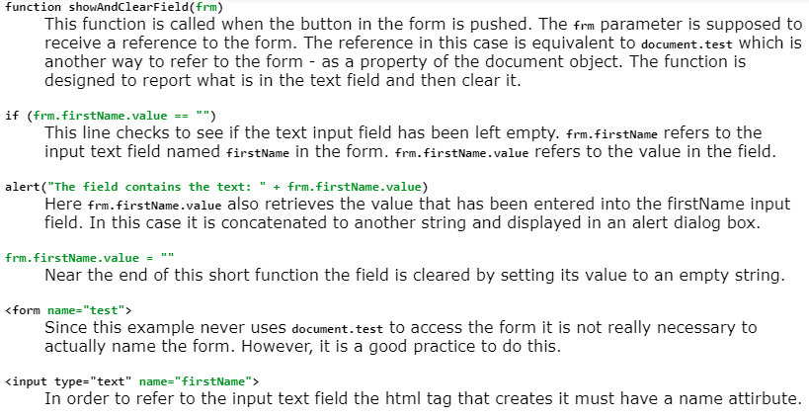
Accessing Form elements – Method 2

Slide 9
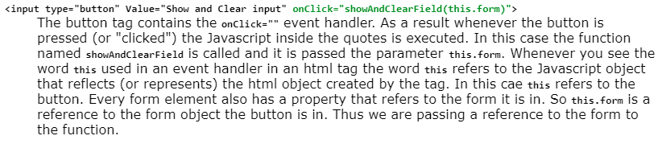
Accessing Form elements – Method 2

Slide 10
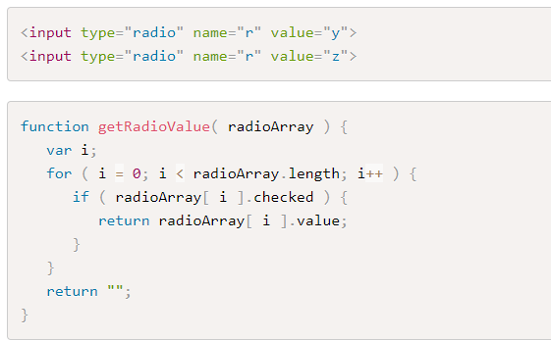
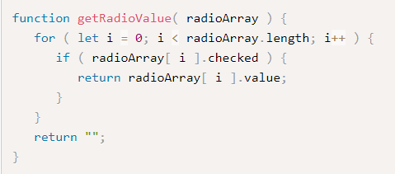
Functions and Forms - Radio buttons
Get the currently selected radio button value from a radio array.
getRadioValue is passed a reference to a radio button array and returns the value of the radio button that is checked or returns a null string.
This is only useful if each radio button has a value defined for it in the html tag that creates the radio button.

Slide 11
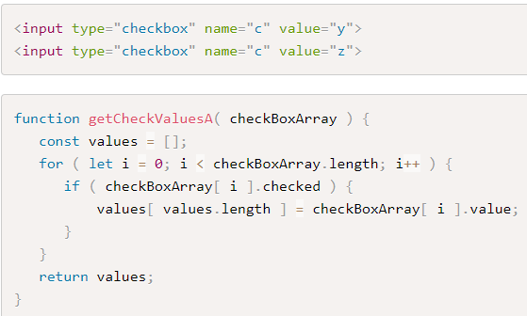
Functions and Forms - Checkboxes
Get an array with the Checked Values
getCheckValuesA is passed a reference to a checkbox array. Since no checkbox, one checkbox, or several checkboxes may be checked this function returns an array of the values of the checked boxes.
If none are checked, the array has a length of zero. This is only useful if each checkbox has a value defined for it in the html tag that creates the checkbox button.

Slide 12
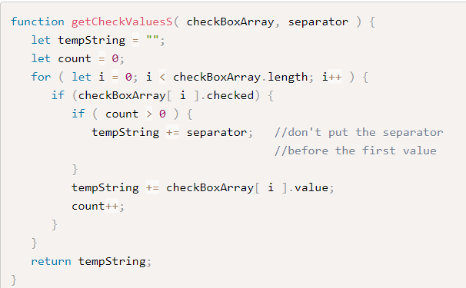
Get a String with the Checked Values
getCheckValuesS is passed a reference to a check box array. Since no checkbox, one checkbox, or several checkboxes may be checked this function returns a string of the values of the checked boxes separated by the value passed in the separator parameter.
If none are checked, the string will be empty. This is only useful if each checkbox has a value defined for it in the html tag that creates the checkbox button.

Slide 13
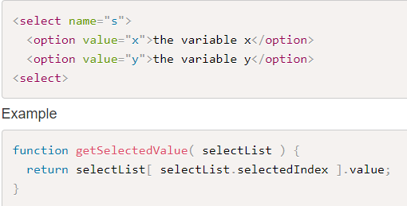
Functions and Forms - Select
Get the Selected Value
getSelectedValue returns the value of the currently selected option in a single item select list. For this to work the value of the option items must be set. For example the function would return "x" or "y" here:

Slide 14
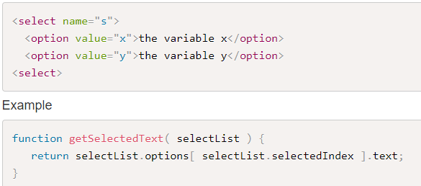
Functions and Forms - Select
Get the Selected Text
getSelectedText returns the text of the currently selected option in a single item selection list. In the example below either "the variable x" or "the variable y" would be returned.

Slide 15
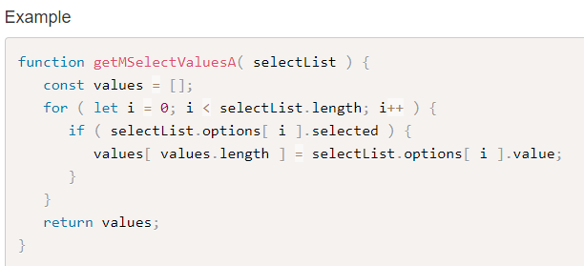
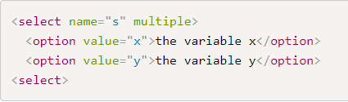
Functions and Forms - Select Multiple
Get an array of Selected Values
The function getMSelectValuesA( selectList ) receives a reference to a multiple selection list and returns an array of the values selected in the list.
In the HTML selection list below, depending on the options selected, this function would return an empty array (if no items were selected) or the values "x" and or "y". Note: for this to work the VALUE attribute of the option tag must be used.

Slide 16
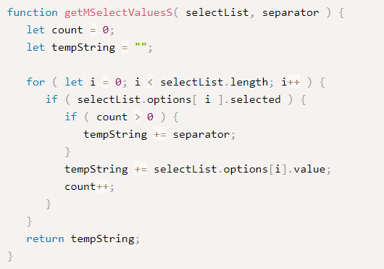
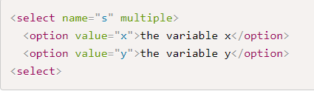
Functions and Forms - Select Multiple
Get the Selected Values as String
The function getMSelectValuesS( selectList, separator ) receives a reference to a multiple selection list and returns string of the values selected in the list. Each value is separated by the character or string passed in the separator parameter.
In the HTML selection list below, depending on the options selected, this function would return an empty string (if no items were selected) or the values "x" and or "y". Note: for this to work the VALUE attribute of the option tag must be used.

Slide 17
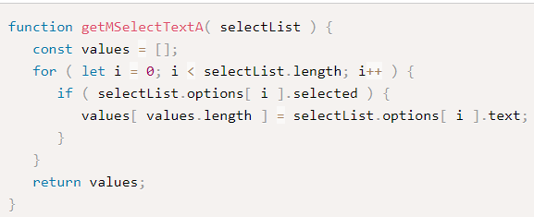
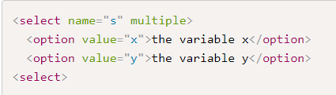
Functions and Forms - Select Multiple
Get an Array of the Selected Text
The function getMSelectTextA( selectList ) receives a reference to a multiple selection list and returns a array of the text selected in the list.
In the HTML selection list below, depending on the options selected, this function would return an empty array (if no items were selected) or the values "the variable x" and or "the variable y".
Note: for this to work the VALUE attribute of the option tag is NOT required as the option text is returned.

Slide 18
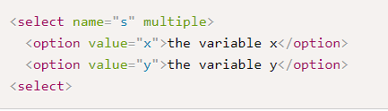
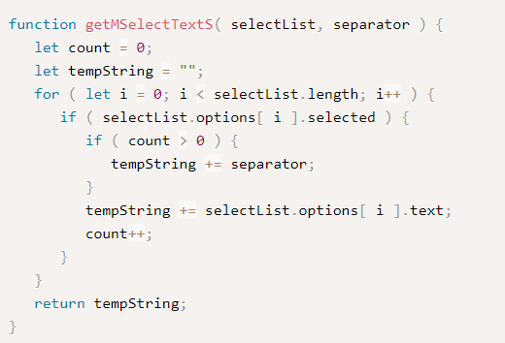
Functions and Forms - Select Multiple
Get a String of the Selected Text
The function getMSelectTextS(selectList, separator) receives a reference to a multiple selection list and returns a string of the text selected in the list.
Each value is separated by the character or string passed in the separator parameter.
In the HTML selection list below, depending on the options selected, this function would return an empty string (if no items were selected) or the values "the variable x" and or "the variable y".
Note: for this to work the VALUE attribute of the option tag is NOT required as the option text is returned.

